Slide 1


Slide 2
Schedule for today
Monday 9th September (am, 11-12)
Small angle scattering introduction (H Barriga)
Introduction to modelling and SasView (W Potrzebowski)
Monday 9th September (pm, 13-14.30)
SasView hands on (W Potrzebowski)
Monday 9th September (pm, 15-17)
Site visit to MAXIV
Tuesday 10th September (am, 9-12)
MAXIV presentations
9 am FragMAX
10 am CoSAXS, Ann Terry
11 am SAXS case study lecture: Lars Nilsson
Tuesday 10th September (pm, 13-17)
SANS capabilities for life science and DEMAX (W Potrzebowski, Esko Oksanen, Zoe Fisher)
Site visit to ESS

Slide 3
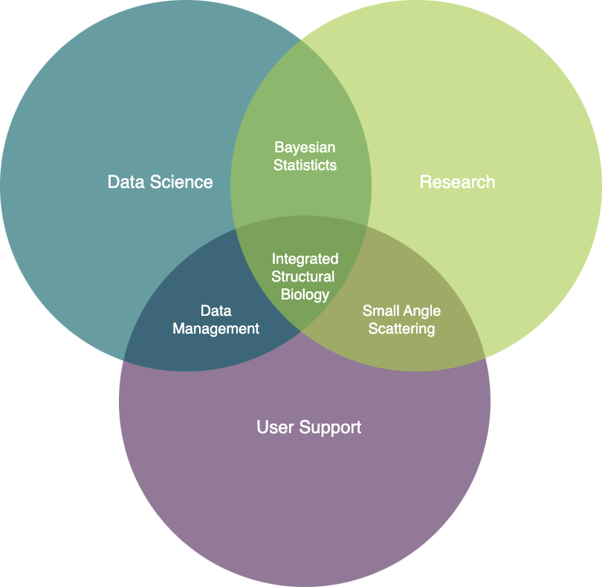
About the teacher(s)

Slide 4

Small Angle Scattering Analysis Toolkit
Integrated Structural Biology Course
Wojtek Potrzebowski
SciLifeLab Lund
wojtek.potrebowski@scilifelab.se

Slide 5
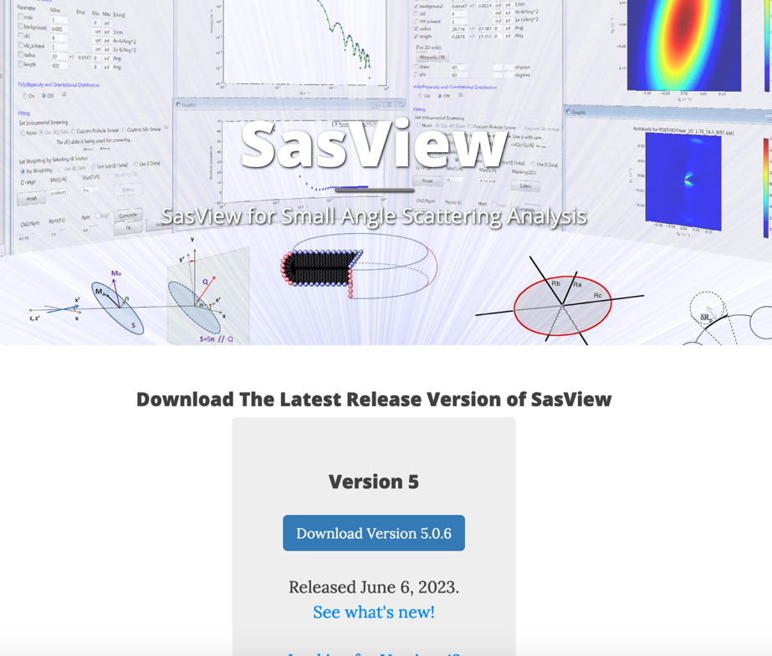
Before we start…
www.sasview.org

Slide 6
Learning objectives
Principles of Small Angle Scattering Data Analysis
Main functionalities of SasView
Form, structure factors and polydispersity
Newly developed features
Hands-on session
1D fitting
Creating custom plugin models
Simultaneous fitting
…

Slide 7


User Journey at Large-Scale Facility
Data reduction
Experiment control
Data streaming
Data analysis
User Office Software
Before experiment
During experiment
During and after experiment

Slide 8
User Journey
Facility
Responsibility+Expertise
Users
User Office Software
Experiment control
Data streaming
Data reduction
Data analysis

Slide 9
Data analysis – facts of life
Data analysis is a part of the processing workflow
Reduced data on the disks is useless
User expertise is critical for successful data analysis
Facilities should support data analysis software but shouldn’t fully drive the process
->We need open and collaborative software tools to succeed!

Slide 10
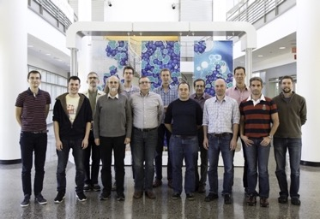
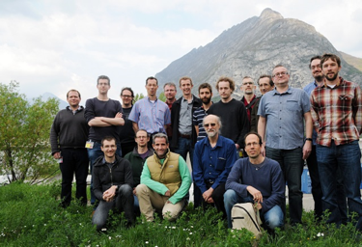
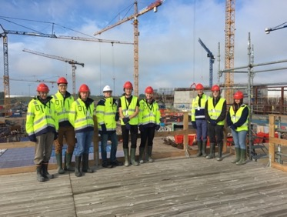
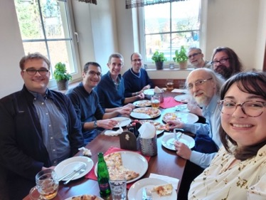
The SasView approach
An open, collaborative, community development
Community driven project
Supported by 10 facilities, 40 contributors (~15 active at any one time)
Small leadership team: Paul Butler (NIST), Steve King (ISIS), Wojtek Potrzebowski (SciLifeLab, formerly ESS)
Biweekly calls
Regular SasView camps and hackathons
Hosted on github: https://github.com/SasView/sasview
Pictures from Code Camps: V, VI, VIII, X
www.sasview.org

Slide 11
Typical fitting workflow
For reduced data:
Load and plot experimental data
Define a model (form and structure factor) with parameters
Fit the parameters so that model matches experimental data
Draw scientific conclusions and publish results!

Slide 12
Scattering Intensity
I(q) = (Δ⍴)² nM² P(q) S(q)
Intensity = Pre-factor * Form Factor * Structure Factor

Slide 13
Pre factor
I(q) = (Δ⍴)² nM² P(q) S(q)
Adapted from Kell Mortensen, e-neutrons.org

Slide 14
Form factors
I(q) = (Δ⍴)² nM² P(q) S(q)
Form factor P(q) represents the interference of neutrons scattered from different parts of the same object
Adapted from Kell Mortensen, e-neutrons.org

Slide 15
Structure factors
I(q) = (Δ⍴)² nM² P(q) S(q)
Structure factor S(q) represents interference between different objects.
Adapted from Kell Mortensen, e-neutrons.org

Slide 16
Form factors determined for different shapes
Credit: Reidar Lund (DOI:10.1007/12_2012_204)

Slide 17
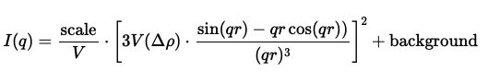
Form factor for sphere

Slide 18
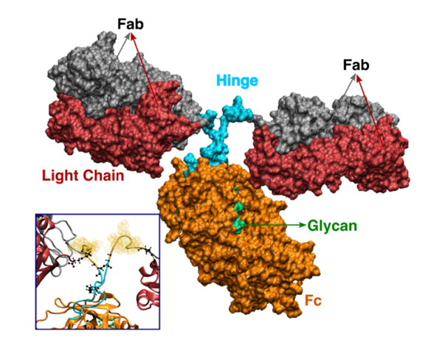
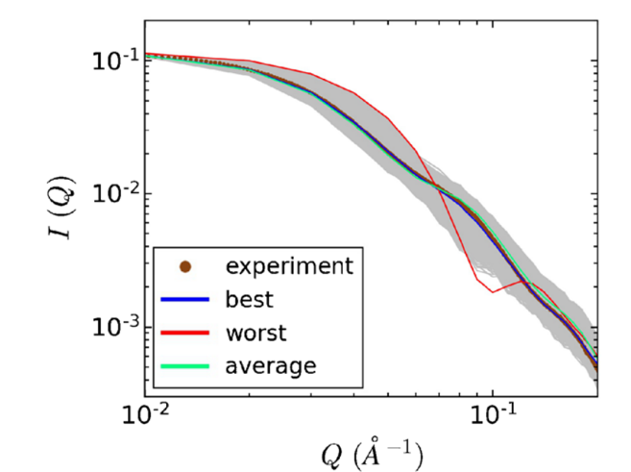
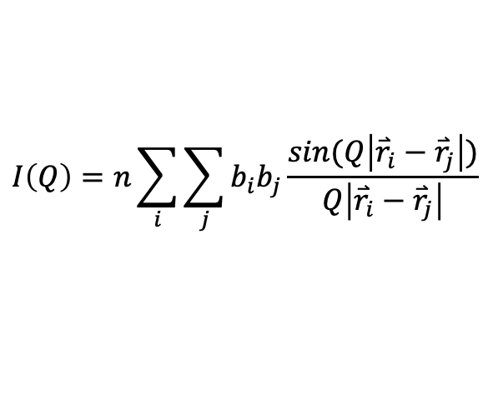
Form factor based on atomic coordinates
Monoclonal antibody protein
$$I\left(Q\right)=n\sum_{i}{\sum_{j}{b_{i}b_{j}\frac{sin(Q\left|{\overset{⃑}{r}}_{i}−{\overset{⃑}{r}}_{j}\right|)}{Q\left|{\overset{⃑}{r}}_{i}−{\overset{⃑}{r}}_{j}\right|}}}$$
b_{i}, b_{j} – atomic form factors
Maria Monica Castellanos et al. Analytical and Bioanalytical Chemistry (2018) 410:2141–2159

Slide 19
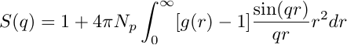
Structure factor
For an isotropic solution:
Diluted
g(r)
Concentrated
g(r)
Ordered
g(r)
Notes:
S(q) is related to the probability distribution function of inter-particles distances, i.e. the pair correlation function g(r)
g(r) = Average of the normalized density of atoms in a shell [r ; r+ dr] from the center of a particle

Slide 20
Determination of Structure Factor
For an isotropic solution:
g(r)
S(q)
1
1
g(r)
S(q)
g(r)
S(q)
Notes:
g)r) average of the normalized density of atoms

Slide 21
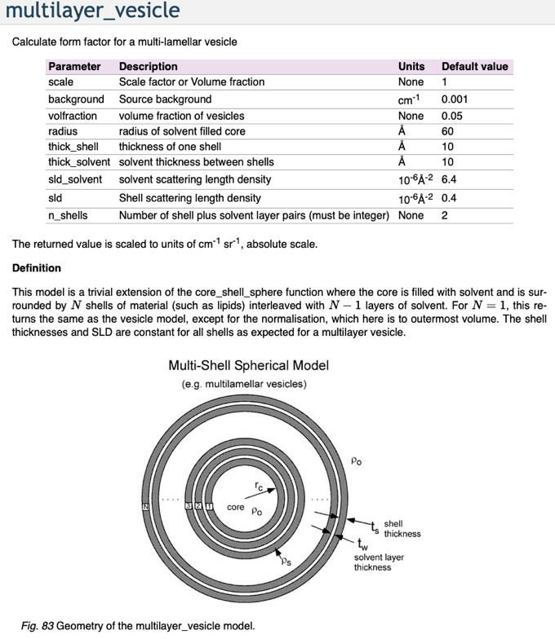
Which model should I use?
Prior knowledge
Literature search
SasView documentation
Usually, more than one model fits
Model-free analysis

Slide 22
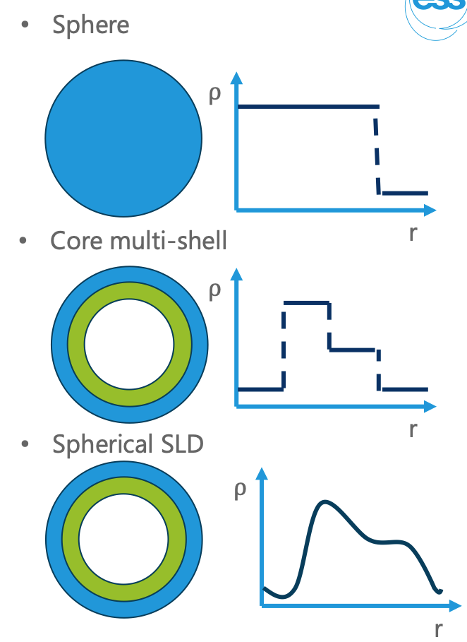
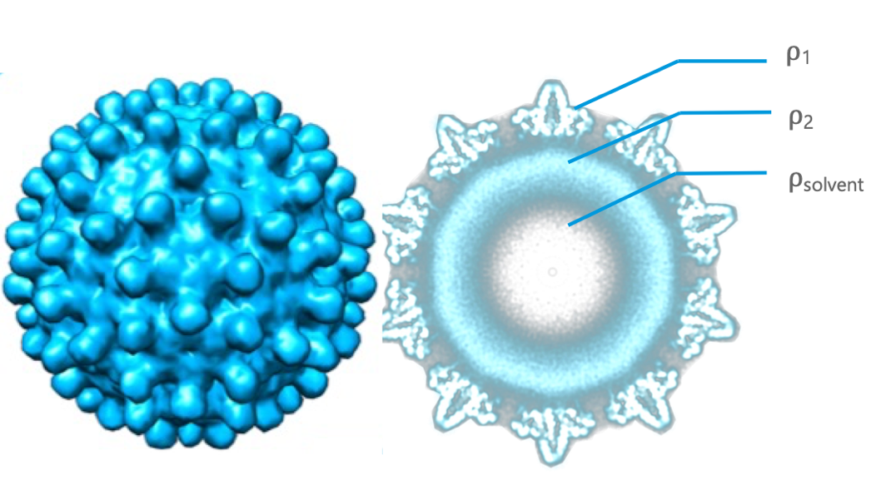
How to represent a virus capsid?

Slide 23
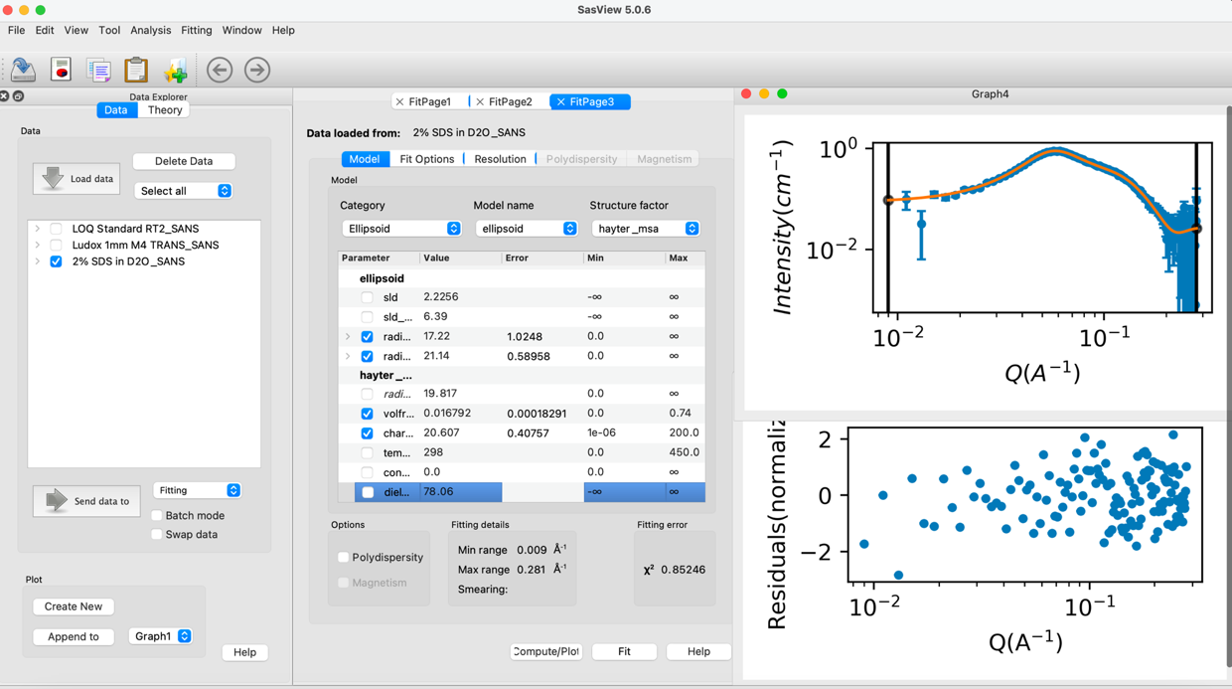
70+ models to explain data
Wide choice of built-in models (> 70)
F(Q), S(Q) & F(Q)*S(Q)
Single, batch and simultaneous 1D and 2D fitting
Data management
Common data formats supported, including NXCansas & cansas1D
Analysis Tool Choice
&
Plotting
Polydispersity (choice of distribution and distribution parameters)
Resolution smearing (pinhole and slit)
Automatically from data or provide parameters

Slide 24
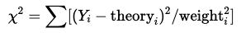
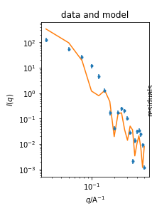
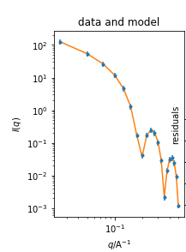
Fitting model to data through χ² optimization
 | Before fit
model
lenght | 350 Å
radius | 35 Å
 | 416.9
After fit
400 Å
40 Å
0.03

Slide 25
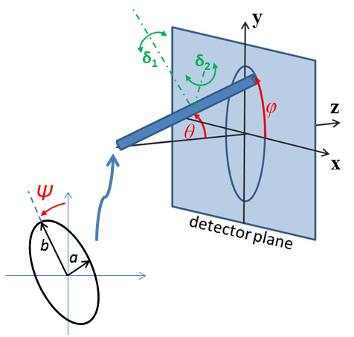
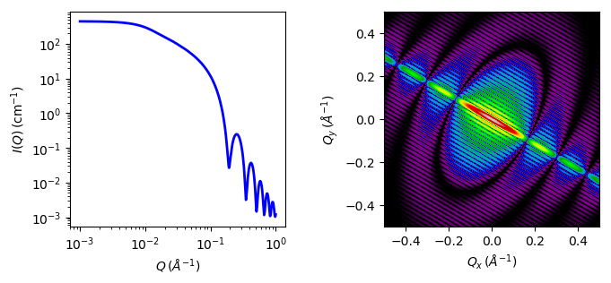
2D fitting for oriented or magnetic particles
1D and 2D cylinder model

Slide 26
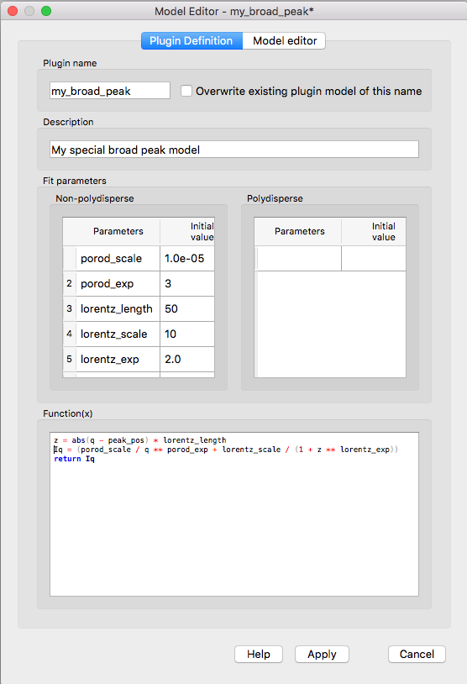
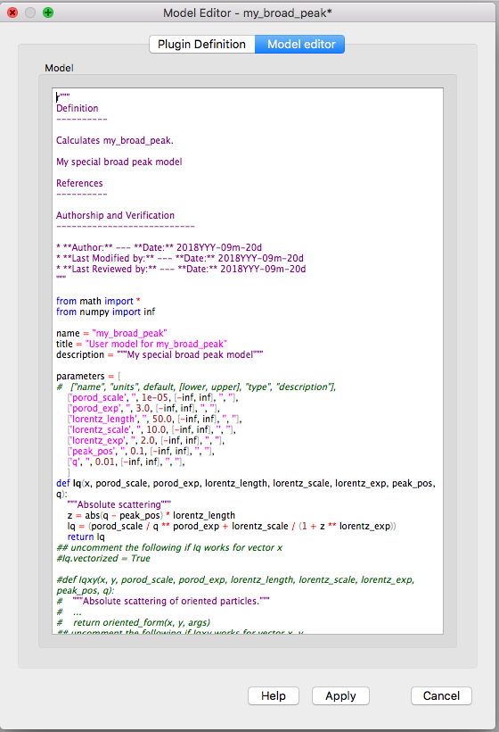
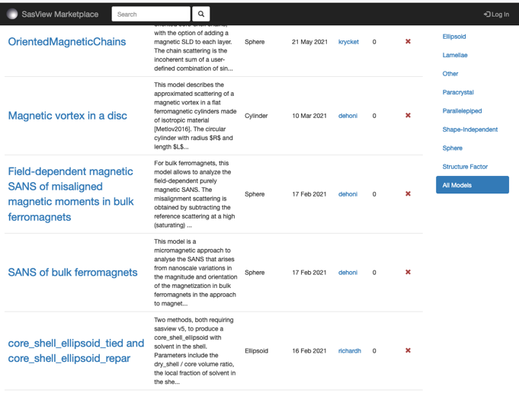
Plugin models
Dedicated editor
Syntax and performance testing
Directly available in SasView ecosystem
Community developed models can be deposited to marketplace: https://marketplace.sasview.org/

Slide 27
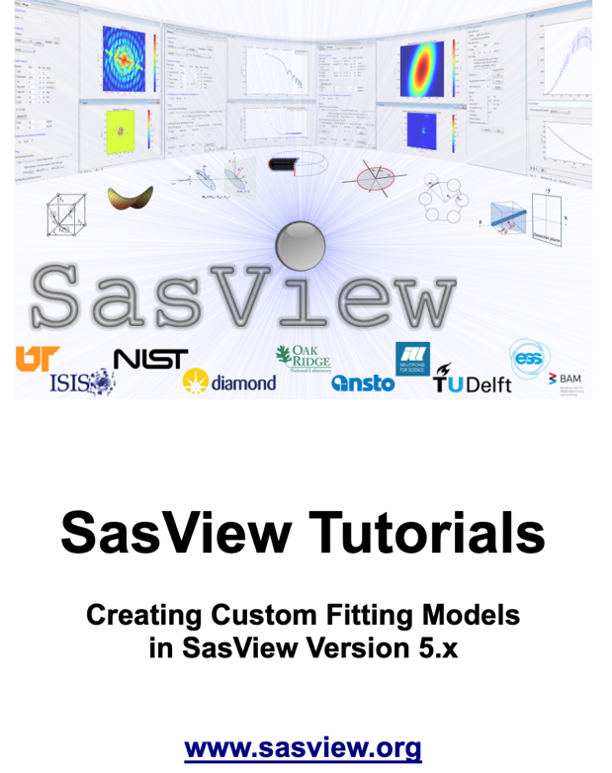
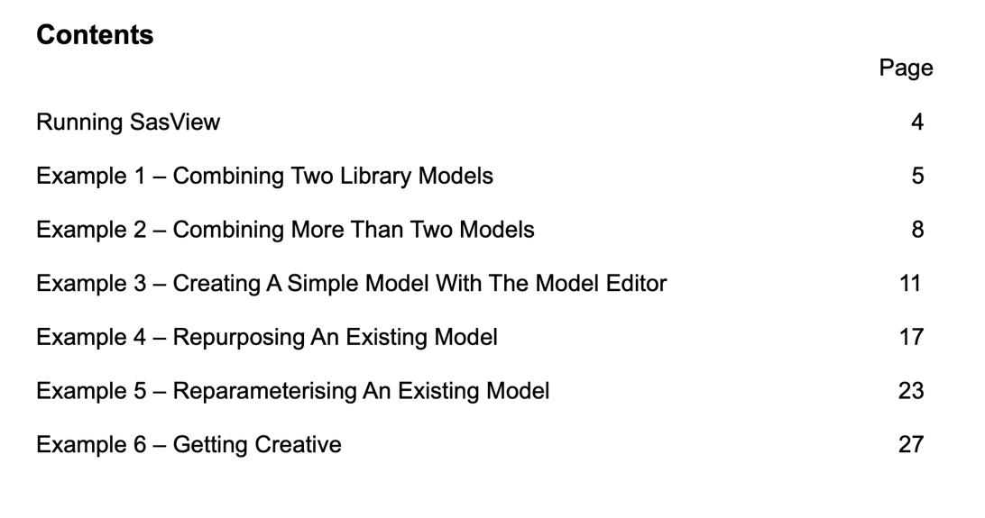
Plugin models tutorial
Available at https://www.sasview.org/download/

Slide 28
Polydispersity
Types of polydispersity:
Size - all particles have similar shape but differ in size, e.g. nanoparticles colloids
Shape – different shape and size (e.g. oligomeric mixtures)
Conformational – particles of identical molecular mass, which adopt different conformations, e.g. disordered or flexible proteins

Slide 29

Size polydispersity
Average intensity for a population of particles that possess size distributions
The resultant intensity is then normalized by the average particle volume

Slide 30
Shape polydispersity
Mixture of components gives combined scattering curve:
Combined curve can be fitted to experimental data I_{exp}(q) to infer v_{k}
volume fractions
normalized scattering intensities

Slide 31
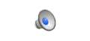
Conformational polydispersity
Flexible and disordered proteins
The same principle as for shape polydispersity:
Large number of parameters = high risk of overfitting
volume fractions
normalized scattering intensities

Slide 32
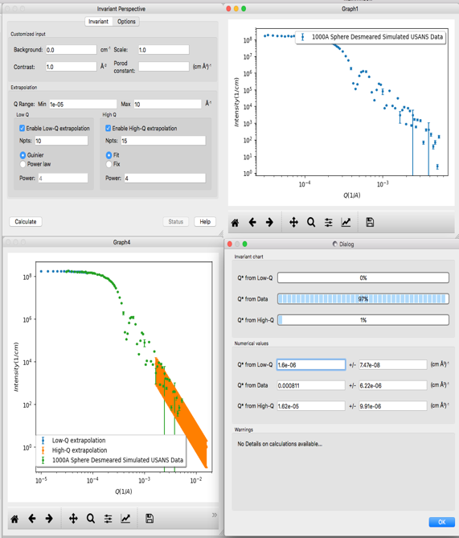
But what if we don’t know the model
Porod (Scattering) invariant can be applied to multiphase systems
Provide independent estimate of volume fractions (porosity) and surface area (reactivity)
It can be used as sanity check

Slide 33
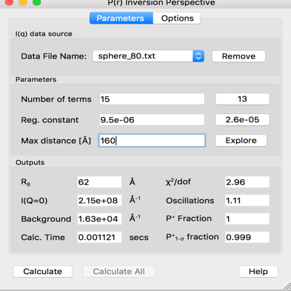
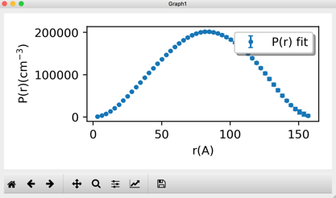
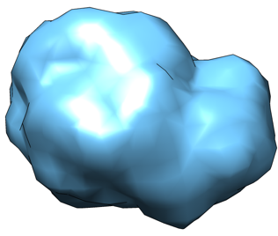
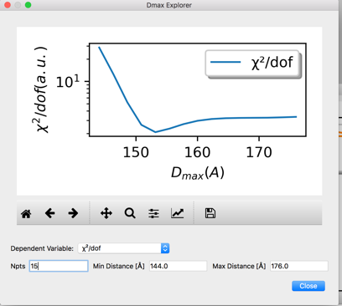
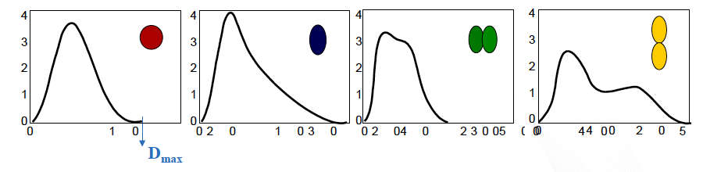
Pair Distance Distribution function P(R)
P(r) - probability of finding a vector of length r between scattering centers
Gives some idea about the shape of the molecule
D_{max}
P(r)
r
r
r
r

Slide 34
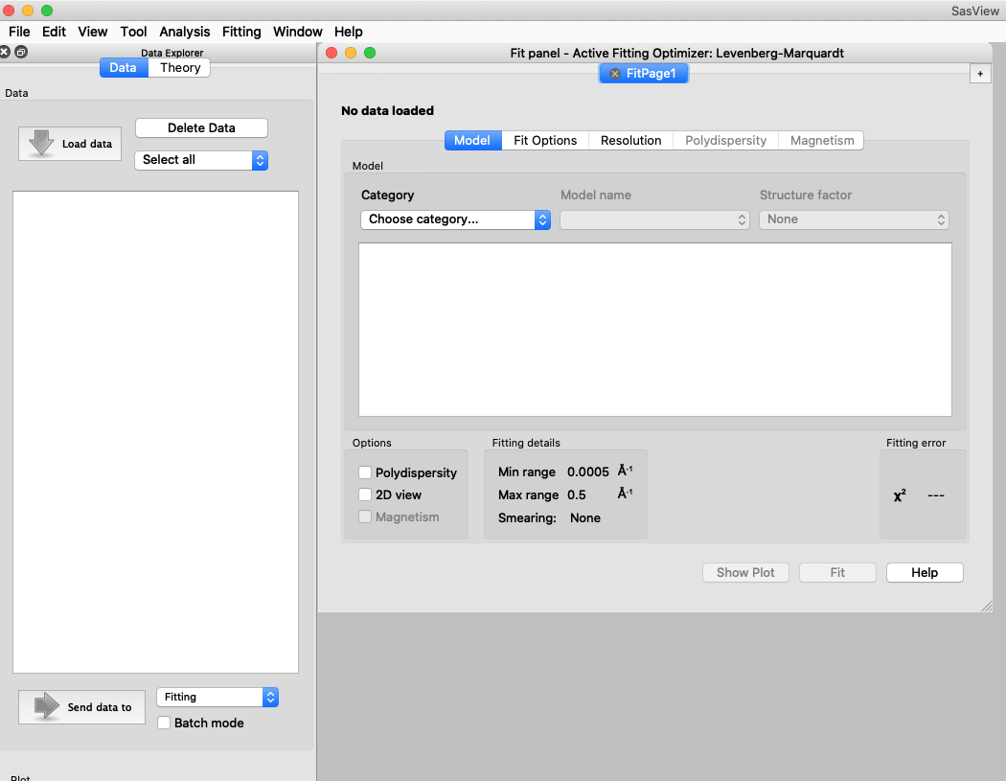
Other SasView functionality
Tools
Data Operation
SLD calculator
Density/Volume calculator
Slit Size Calculator
Kiessig Thickness Calculator
Q Resolution Estimator
Generic Scattering calculator
Orientation Viewer
Python Shell/Editor
Image Viewer
File Converter
Analysis
Fitting
Invariant
Pr Inversion
Correlation Function

Slide 35
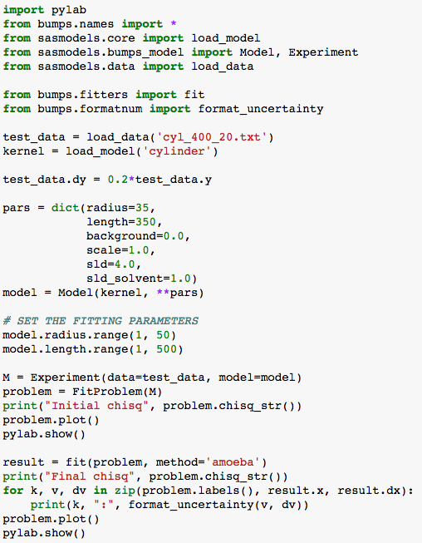
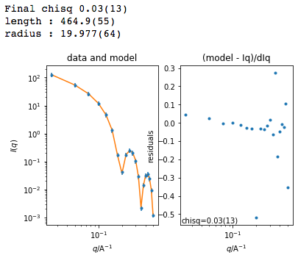
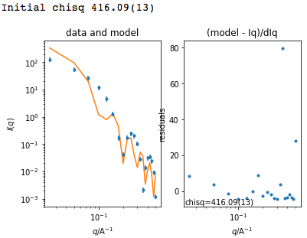
Beyond Graphical User Interface (GUI)
Useful for batch jobs and reproducibility
Scripts can be run on computer cluster
Before fit
After fit

Slide 36
Beyond Graphical User Interface (GUI)
sasview
sasdata
sasmodels
bumps
Python installation
For fitting, there is no need to install sasview
Pip install sasmodels sasdata bumps
It can be run on computer clusters (also with GPU)

Slide 37
SasView collaboration
Those who bring the resources (time, effort, funds) choose what to work on
but cannot break existing experiences ...

Slide 38
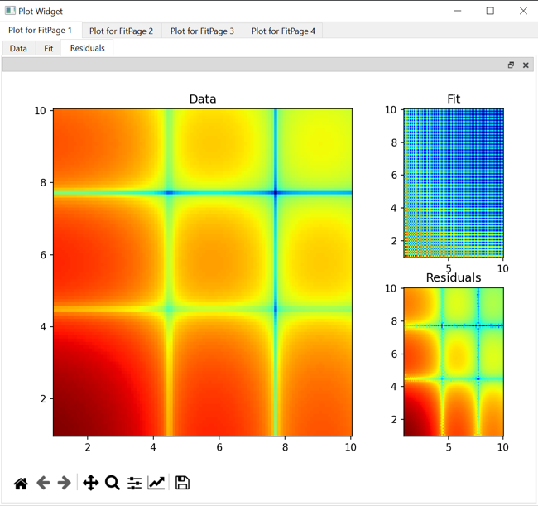
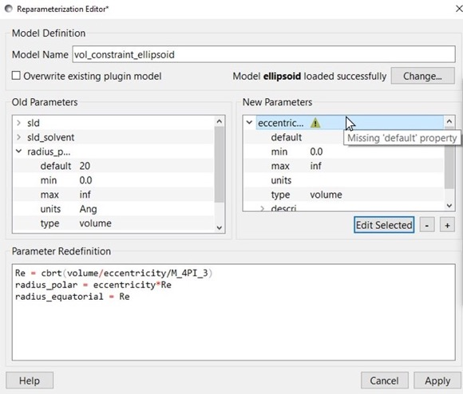
Student projects and ”external” contributions
Simultaneous SAXS and SANS fitting
Improvements in:
Plotting
Data structure
Documentation
Plugin Editor
Slicers
Generic Scattering Calculator
Web-based API
Pore size distributions
Contributors: Iestyn Cadwallader-Jones, Nouhalia Agouzal, Dorian Lozano, Julius Karliczek (ILL), Ellis Hewis, James Crake-Merani, Ruben Lopes (ISIS), Alex Zheng (NIST), Brayden Miller (NIST), Xael Shan (NIST), Anita Zhang (Princeton), Kristian Lytje (Arhus University)

Slide 39
Combined SAXS and SANS
Simultaneous measurements on the same sample
Running at D22 instrument at ILL
Low-flux SAXS source
Specialized sample environment
Non-trivial data analysis
SasView (6.0.0) provides a weighting mechanism in simultaneous fitting
Notes:
High-energy gamma radiation gives rise to backgrounds

Slide 40
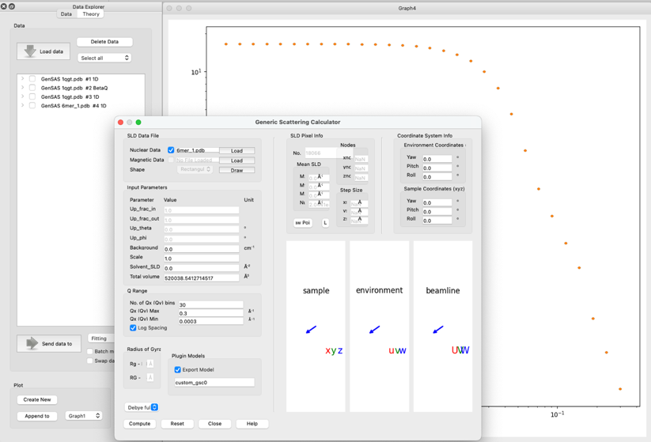
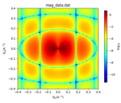
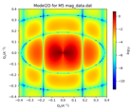
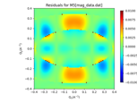
Generic Scattering calculator improvements
Magnetic/polarized SANS
Generic Scattering Calculator supports magnetic/polarized SANS
Coordinate data in VTK formats supported
Interacting bio-molecules
Generate scattering profile from PDB file
Save as a custom/plugin model
Use for fitting with structure factors (including beta approximation)
PDB reader and engine refactored
Validation of electron-microscopy maps using solution small-angle X-ray scattering
Kristian Lytje and Jan Skov Pedersen, Volume 80| Part 7| July 2024| Pages 493-505

Slide 41
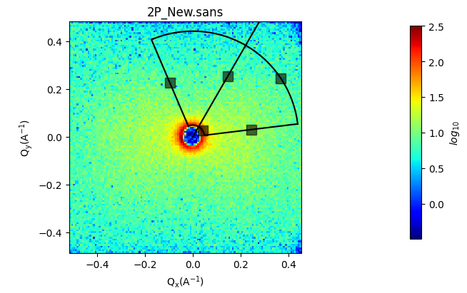
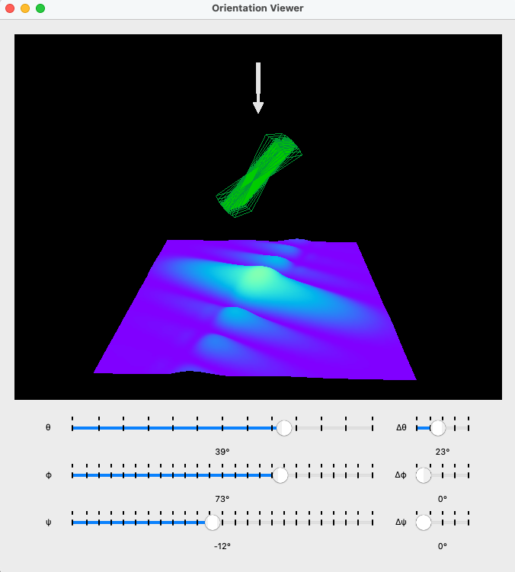
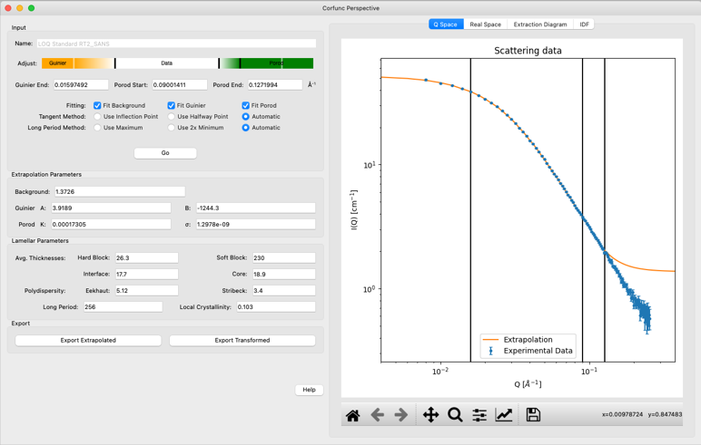
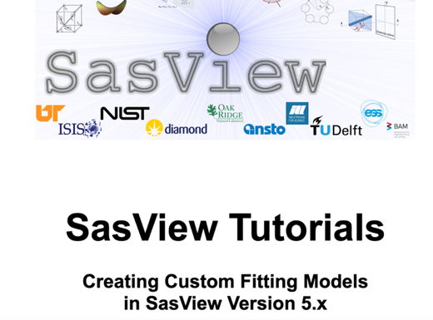
SasView 6.0.0-beta release
Orientation viewer available
Corfunc perspective refactored
Simultaneous fitting allows for a weighting scheme
Preferences panel with display and plotting options
Improved label handling on plots
Residuals plots refactored
PDB reader refactored
Wedge slicer added
Sasdata package separated
Custom Model writing tutorial
https://github.com/SasView/sasview/releases/tag/v6.0.0-beta-2

Slide 42
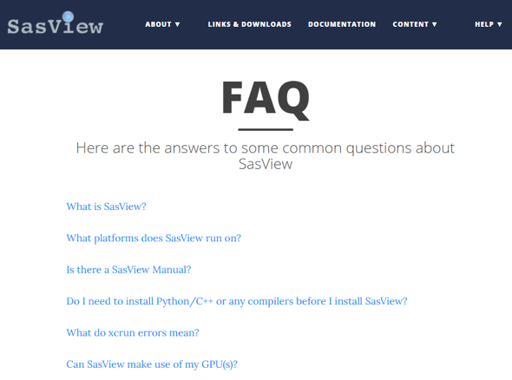
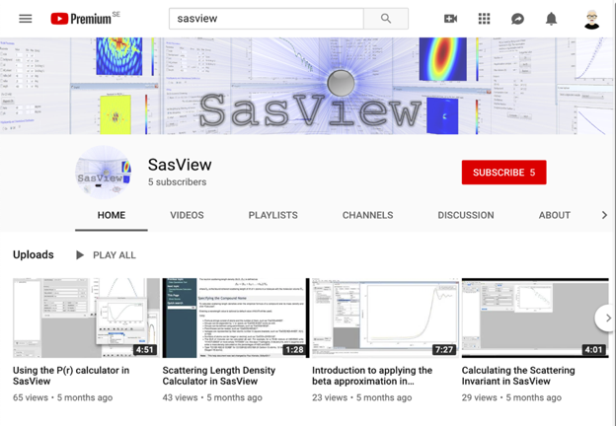
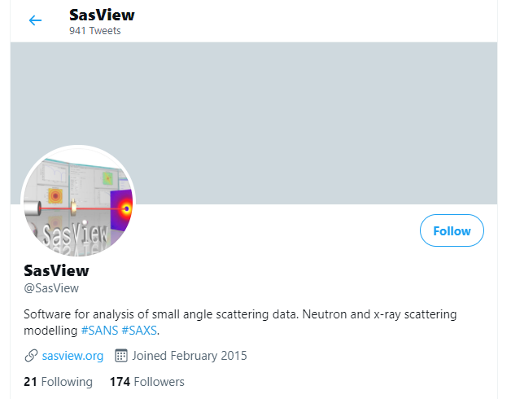
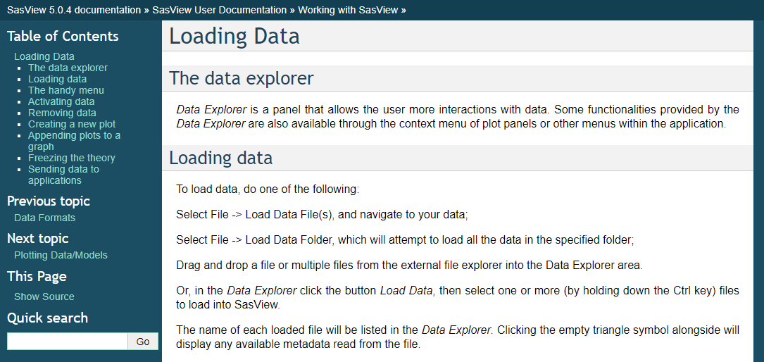
Resources for users and contributors
Website
Documentation
in-program & online
Written Tutorials
Video Tutorials (YouTube)
Taught Courses
scattering schools/workshops
university courses
Bootcamps & regional workshops
e-Learning
Slack
Linkedin
(Marketplace)
help@sasview.org
users@sasview.org

Slide 43

Different approaches to SAS data analysis
Not in SasView scope
https://www.isis.stfc.ac.uk/Pages/SANSdataanalysisOverview.aspx

Slide 44

ATSAS
https://youtu.be/T7r583F8qDM?si=tGViSEsWX6nYB-0v

Slide 45
Questions?

Slide 46

Hands-on session
New to SasView? Start here
3
2
4
https://www.sasview.org/documentation/

Slide 47
Experimenting with SasView
Download SasView 6.0.0 and try out new features:
https://github.com/SasView/sasview/releases/tag/v6.0.0-beta-2
Run SasView from the script:
Setup python environment
Install required packages
Play with some of the notebooks: https://github.com/SasView/documents/tree/master/Notebooks

Slide 48
Thank you!

Slide 49







Thank you, Sponsors!!

Slide 50

Correlation function

